Slide 1



Walmart Sales Prediction Analysis
View in Power BI
Last data refresh:
28/04/2025 12:45:00 UTC
Downloaded at:
28/04/2025 12:46:15 UTC

Slide 2
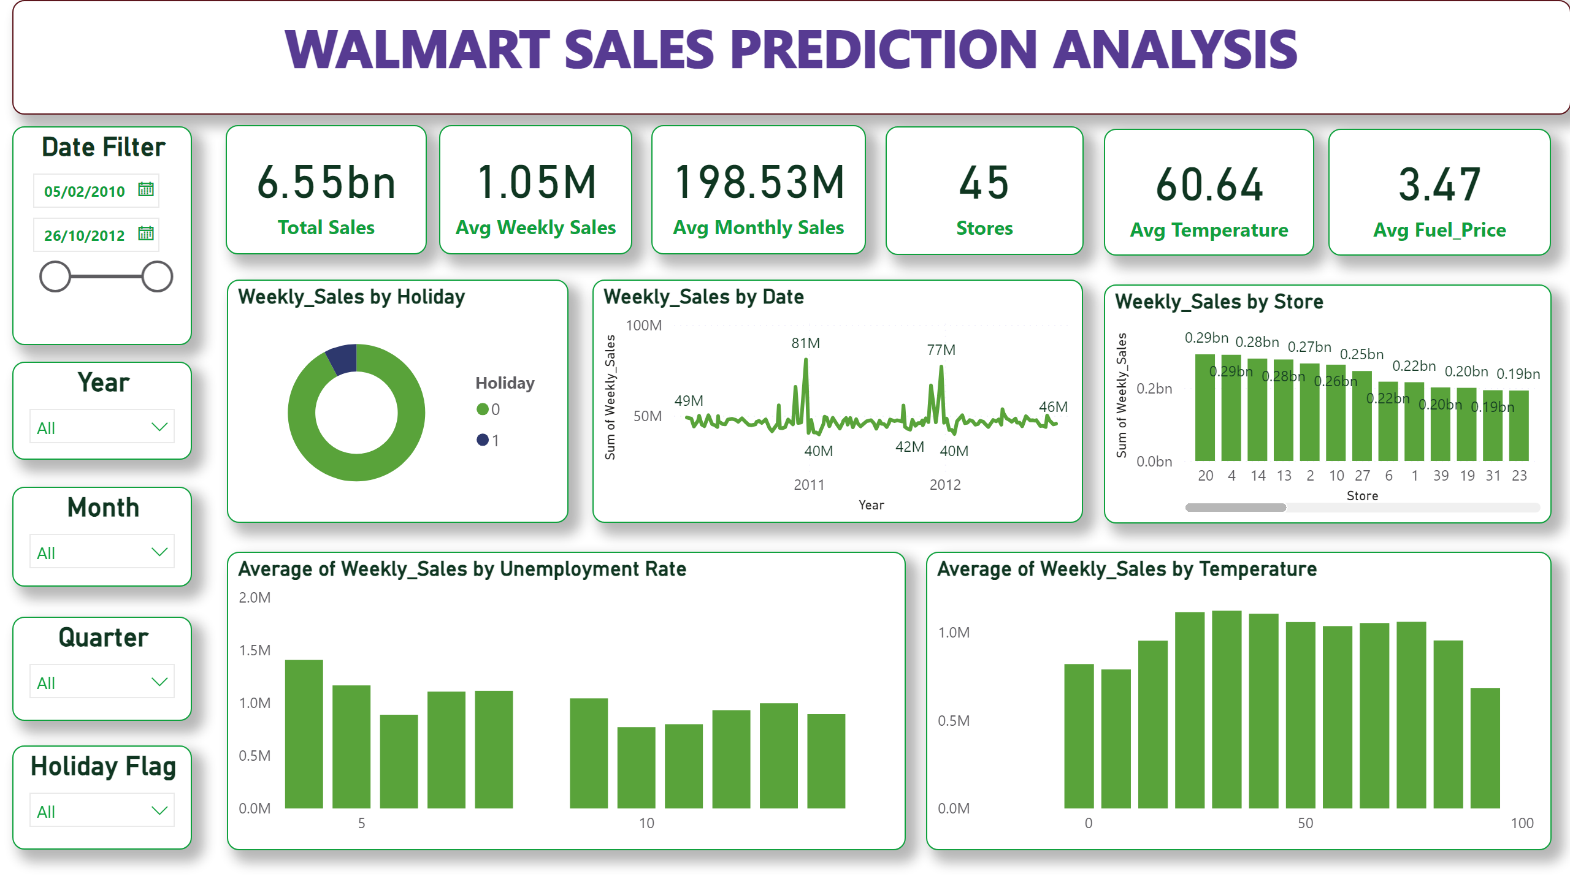
Page 1
Notes:
textbox
No alt text provided
card
No alt text provided
card
No alt text provided
card
No alt text provided
Date Filter
No alt text provided
card
No alt text provided
card
No alt text provided
card
No alt text provided
Year
No alt text provided
Weekly_Sales by Holiday
No alt text provided
Weekly_Sales by Date
No alt text provided
Weekly_Sales by Store
No alt text provided
Average of Weekly_Sales by Unemployment Rate
No alt text provided
Average of Weekly_Sales by Temperature
No alt text provided
Holiday Flag
No alt text provided
Month
No alt text provided
Quarter
No alt text provided

